Slide 1

Network Cards

Slide 2
Objectives
1. Network Interface Cards (NIC) Basics
2. Choosing Network Adapters for Best Performance
3. Special-Purpose NICs
4. Driver Software

Slide 3
Network Interface Cards (NIC) Basics
1.1. From Parallel to Serial and Vice Versa
1.2. Additional Functions of a NIC
1.3. PC Buses
1.4. Other PC Interfaces Used for Networking
1.5. Principles of NIC Configuration
1.6. Integrated NICs
1.7. Making the Network Attachment

Slide 4
For any computer, a network interface card (NIC) performs two crucial tasks
Establishes and manages the computer’s network connection
Translates digital computer data into signals (appropriate for the networking medium) for outgoing messages, and translates signals into digital computer data for incoming messages
NIC establishes a link between a computer and a network, and then manages that link

Slide 5
From Parallel to Serial and Vice Versa
NICs also manage transformations in network data’s form
The computer bus has series of parallel data lines
Parallel transmission
For nearly all forms of networking media, signals traversing the media consist of a linear sequence of information that corresponds to a linear sequence of bits of data (serial transmission)
To redistribute serial data to parallel lines (and vice versa), one of the most important components on a NIC is memory, which acts as a buffer

Slide 6
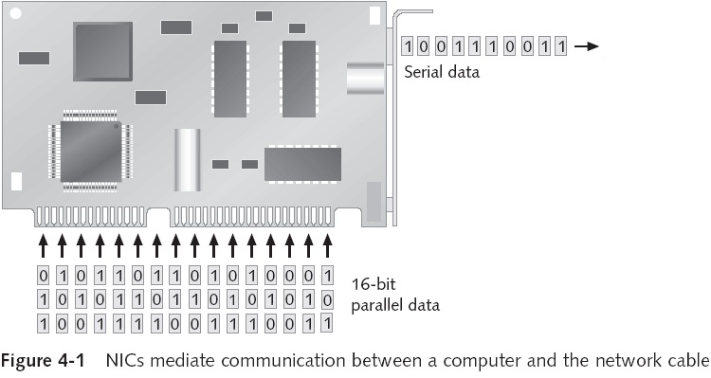
Bus width

Slide 7
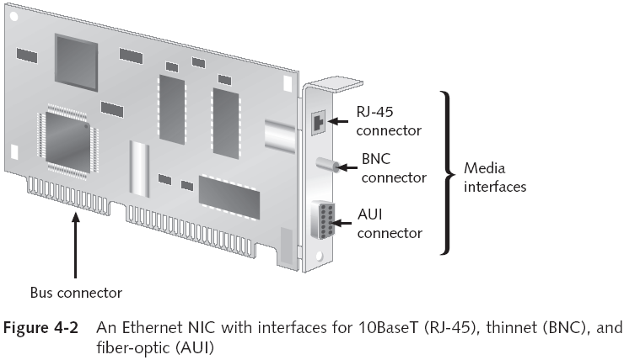

Slide 8
Additional Functions of a NIC
Creates, sends, and receives frames
Frame: fundamental unit of data for network transmission and reception
Deals with frame-level errors and incomplete or unintelligible frame structures
Manages access to medium
Acts as gatekeeper (permits inbound communications aimed only at its computer (or broadcast) to pass through NIC and on to CPU)
Each card has a unique MAC address in ROM
Promiscuous mode disables gatekeeper functions

Slide 9
PC Buses
When PCs were introduced, only a single bus design existed: a limited 8-bit bus
As technology evolved, other buses came along
Peripheral Component Interconnect (PCI)
PCI-X
PCI Express
PCMCIA cards
Industry Standard Architecture (ISA)

Slide 10
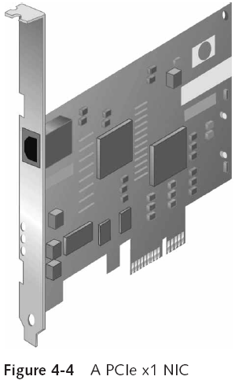
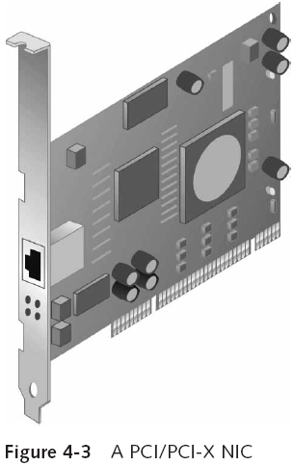

Slide 11
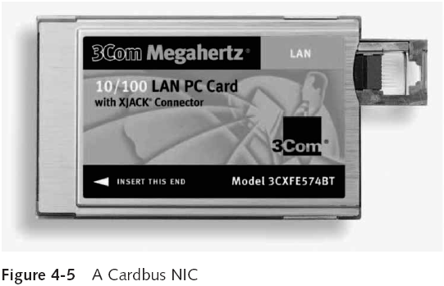

Slide 12
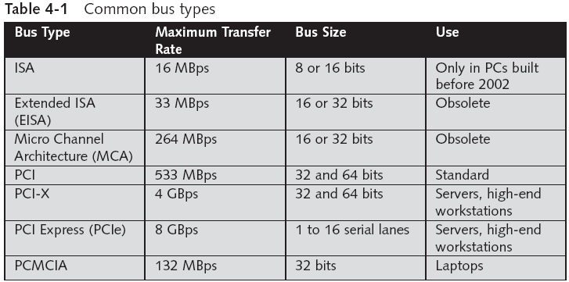

Slide 13
Other PC Interfaces Used for Networking
Although the following interface technologies don’t replace the buses in most typical PCs, they do offer other ways to attach computers to networks:
Universal Serial Bus (USB)
USB 1.0 can operate at up to 12 Mbps
USB 2.0 can operate at up to 480 Mbps
FireWire (also known as IEEE 1394)
Can operate up to 400 Mbps
IEEE 1394b supports transfer rates up to 3200 Mbps

Slide 14
Principles of NIC Configuration
Microsoft introduced Plug and Play (PnP) architecture with Windows 95
Defines a set of configuration protocols so that a computer can communicate with its peripherals during the power-on self test (POST) sequence and auto-negotiate a working configuration
NIC configuration involves modifying settings
Interrupt request line (IRQ)
Base I/O port
Base memory address

Slide 15
Integrated NICs
On-board NICs: Most PC motherboard and laptop computer manufacturers integrate the network interface directly on to the motherboard
Might not meet a user’s needs
Wrong media
Wrong speed
Wrong architecture
Most on-board NICs are suitable for most users’ requirements

Slide 16
Making the Network Attachment
NICs perform several vital roles to coordinate communications between computer and network
Establishing a physical link to networking medium
Generating signals that traverse networking medium
Receiving incoming signals
Implementing controls for when to transmit signals to or receive signals from the network medium
It is essential that you matching the adapter you choose with the medium it must attach to
Some NICs support multiple media types, and configuration is usually automatic or uses SW

Slide 17
Choosing Network Adapters for Best Performance
The hardware-enhancement NIC options include:
Direct Memory Access (DMA)
Shared adapter memory
Shared system memory
Bus mastering
RAM buffering
On-board co-processors
Various security options
Traffic management (Quality of Service (QoS))
Automatic link aggregation
Improved fault tolerance
Improved management features

Slide 18
Increased performance features have payoffs for servers that might not apply to workstations
The following is a checklist for purchasing NICs:
Bus width—Higher is better
Bus type—Use 64-bit PCI-X or PCIe for servers
Memory transfer—Shared memory outpaces I/O or DMA
Special features—Choose security, management, protocol-handling, and hot-plug capabilities
Bus mastering—Important for servers
Vendor factors—Look for quality, reliability, staying power, and reputation

Slide 19
Special-Purpose NICs
3.1. Wireless Adapters
3.2. Remote Boot Adapters

Slide 20
In addition to straightforward network adapters, several types of cards deliver specialized capabilities
They include interfaces for wireless networks, as well as a feature for so-called diskless workstations (“thin clients”), which must access the network to load an OS when they boot
These cards are said to support remote booting or remote initial program load

Slide 21
Wireless Adapters
Wireless interfaces usually incorporate some or all of the following components:
Indoor antenna and antenna cable
Software to enable the adapter to work with a particular network environment
Diagnostic software
Installation software
Wireless NICs are commonly used with an access point to add wireless elements to an existing LAN
Select: speed, wireless standard, other (e.g., security)

Slide 22
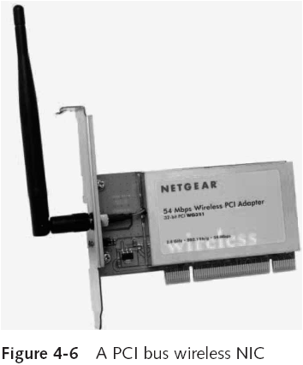

Slide 23
Remote Boot Adapters
The network must be the source of access to the programs needed to start a diskless workstation
Some NICs include a chip socket for a special bit of circuitry called a Boot PROM, which is referred to as preboot execution environment (PXE) compliant
Remote boot adapters offer several advantages
Cost savings because no hard drive is required
Improved reliability (hard drives are a common source of problems)
Security is increased (no sensitive data can be stored on the computer)
Virus attacks are useless

Slide 24
Driver Software
4.1. NIC Driver Configuration
4.2. Wireless NIC Configuration

Slide 25
Device driver: small, specialized program that represents a device to an OS and manages communications between the OS and NIC
Incorrect/poorly written drivers can have negative impact on performance or prevent PC from booting
Major vendor standards for drivers
Network Device Interface Specification (NDIS)
Win32 Driver Model (WDM)
Open Data-link Interface (ODI)
Installing a driver for a NIC is usually easy

Slide 26
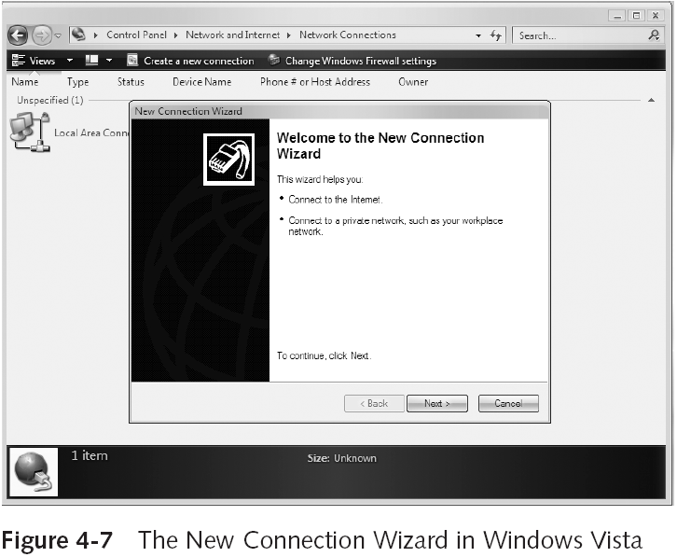

Slide 27
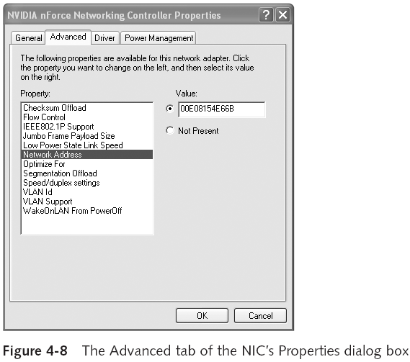
NIC Driver Configuration

Slide 28
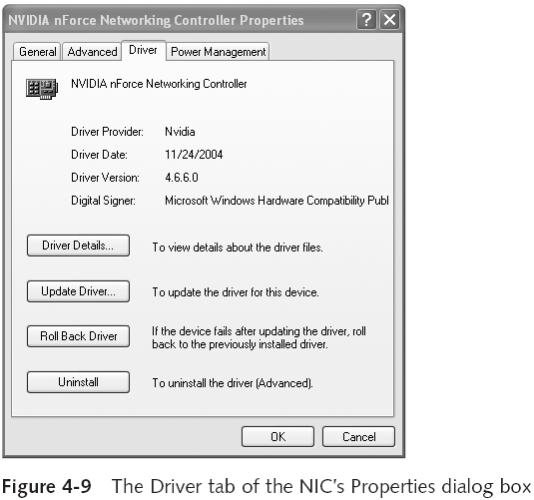

Slide 29
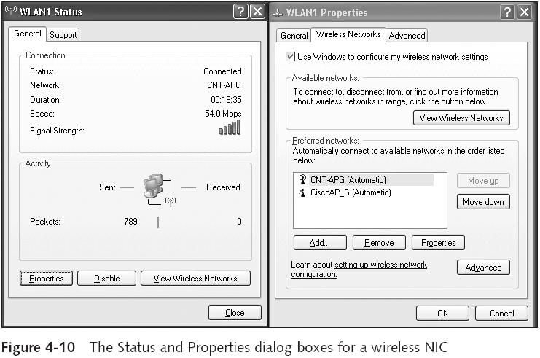
Wireless NIC Configuration

Slide 30
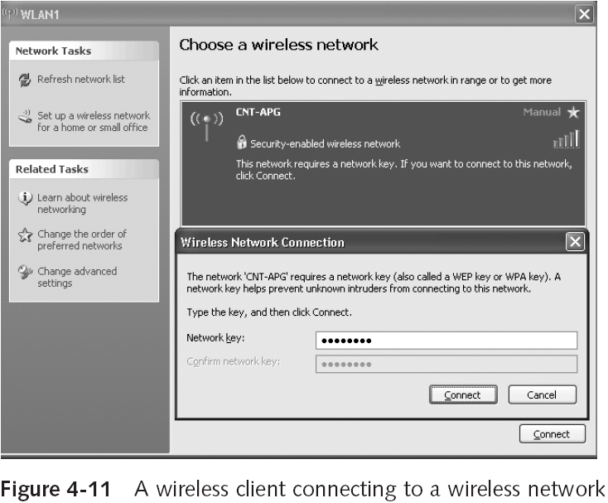

Slide 31
Summary
NICs supply the interface between a computer and the networking medium
When sending data, a NIC reformats outgoing data from the parallel form that arrives through the computer’s bus to the serial form used over most media; to receive data, the process is reversed
NICs have options that must be set for an adapter to make a working network connection (usually PnP)
NIC’s edge connector must match the PC slot
Many motherboards have integrated NICs
Network adapters can have a profound effect on overall network performance

Slide 32
When purchasing a network adapter, consider the following checklist: bus width, bus type, memory transfer, special features (such as security), bus mastering, and vendor factors (such as support)
When purchasing a wireless NIC, keep in mind the Wi-Fi standard you want to use
Driver software permits a NIC to communicate with a computer’s operating system
NIC driver configuration can be auto-configured, or it might require setting some options

